Slide 1
Databricks SQL- Plotly, Dash For Visualization

Slide 2

Agenda
Introduction
Why Plotly Resampler?
High level steps
Conclusion

Slide 3

This aims to offer a comprehensive guide on our process of visualizing extremely large time-series data stored in Databricks. We achieved this using advanced aggregation and downsampling techniques available in the Plotly Resampler. Finally, we integrated these two technologies to create a Dash-powered, Polars-optimized, Plotly production data application.
Introduction

Slide 4
Why Plotly Resampler?
The Plotly Resampler is an extension of Plotly’s Python bindings, improving the scalability of line charts within an interactive toolkit by consolidating the underlying data based on the current graph view. This can significantly enhance your visualization of extensive sets of sequential data.

Slide 5
High-level steps
A Databricks workspace with Databricks SQL enabled (DB SQL is enabled by default in Premium Workspaces or above)
A DB SQL endpoint or Databricks cluster with 9.1 LTS or higher (data engineering cluster)
A personal access token in Databricks to authenticate SQL Endpoint via API
A Python development environment (>=v 3.10). It is recommended to use VSCode for a local IDE and utilize Conda or virtual env to manage dependencies, along with black for automatic code formatting.

Slide 6
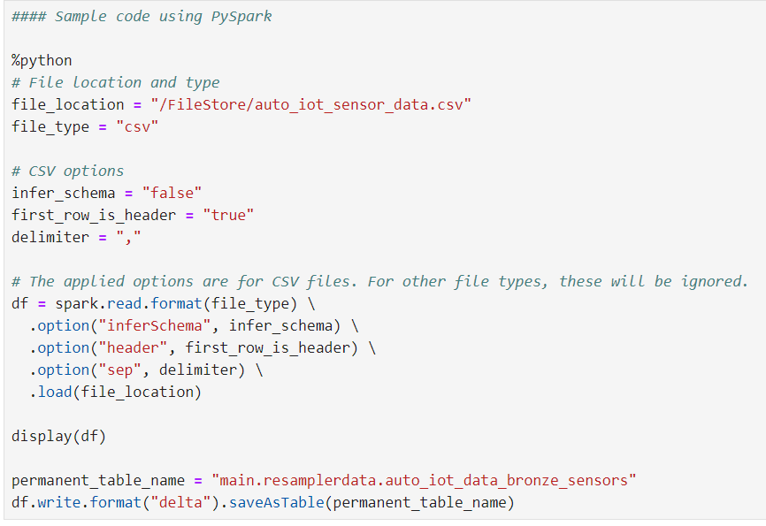
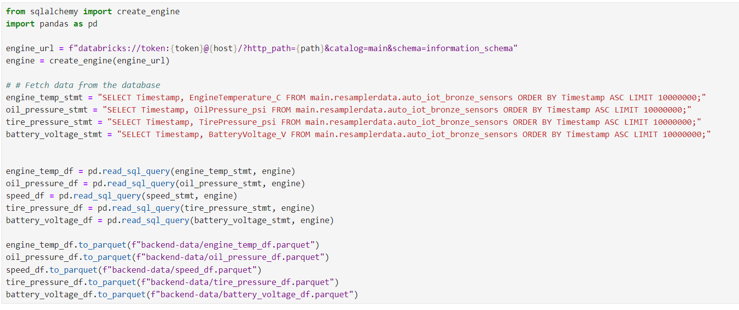
Table Creation code
Code Using sqlalchemy- Query Development

Slide 7
Conclusion
working with large-scale time-series data visualization, the Plotly Resampler's functionalities truly work out, especially when paired with Databricks ecosystems. It's not just the capacity to manage extensive datasets that sets it apart, but also its distinctive interactive features. These, combined with extensive customization choices and significantly improved performance, establish it as an essential tool for individuals working with expansive time-series data. Although Datashader is praiseworthy, particularly for its innovative rasterization methods and integration with Bokeh, it may not offer the same level of user-friendly interactivity as the Plotly Resampler.
GitHub: https://github.com/ds-stratgic-work/Databricks-SQL-Plotly-Dash.git

Slide 8


Thank You
dSights is a data tech specialist with a vision to create value through:
Outcome-Oriented AI
Fueled by
Innovative Experimentation

